Slide 1
Fundamental Programming Concepts
Lecturer: Ngo Huy Bien
Software Engineering Department
Faculty of Information Technology
VNUHCM - University of Science
Ho Chi Minh City, Vietnam
nhbien@fit.hcmus.edu.vn

Slide 2

Objectives
To create basic data types.
To write basic programming statements.
To write a simple program.

Slide 3

References
Tom Archer and Andrew Whitechapel (2002). Inside C#. Microsoft Corporation.
Herbert Schildt (2010). C# 4.0 The Complete Reference.
Dan Clark (2013). Beginning C# Object-Oriented Programming.
RB Whitaker (2015). The C# Player's Guide.

Slide 4
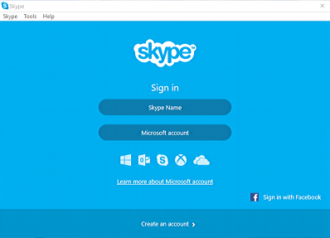
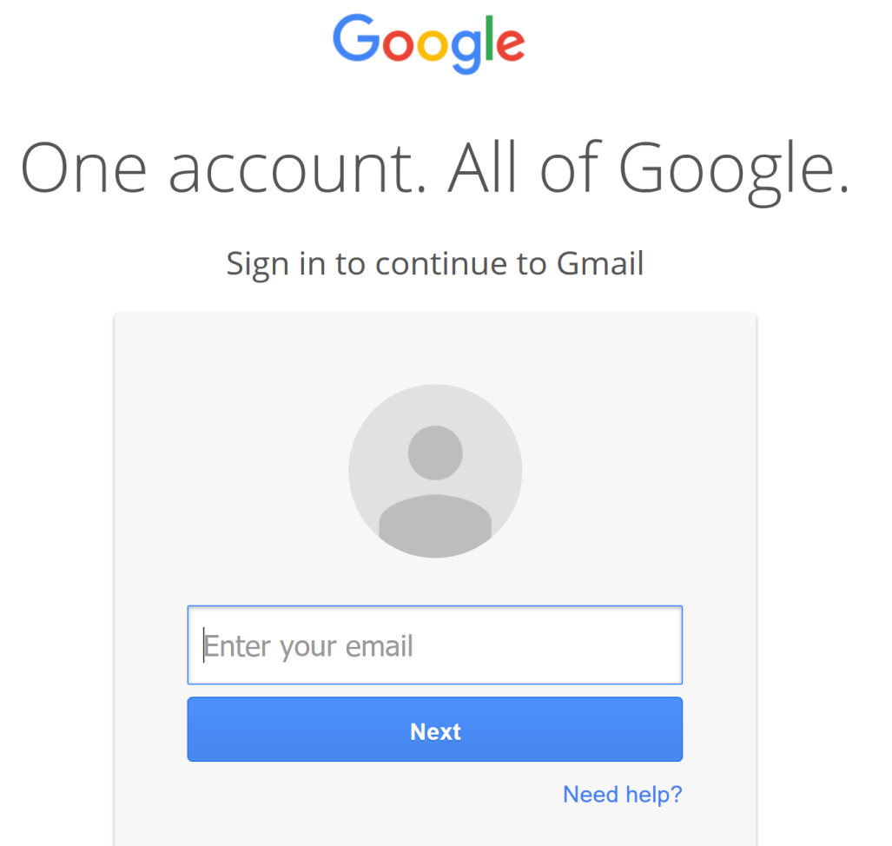
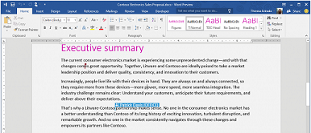
Applications

Slide 5
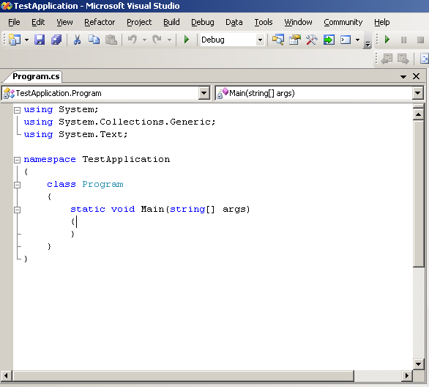
Source Code

Slide 6
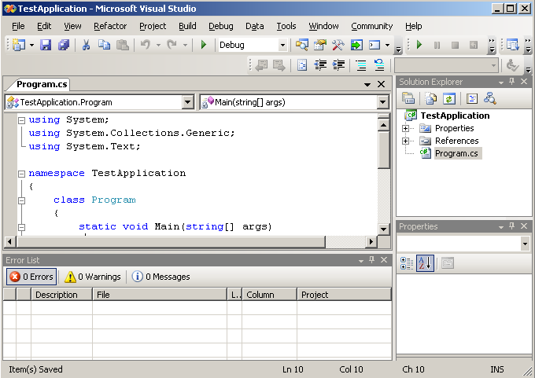
Integrated Development Environment
A source code editor
A compiler and/or an interpreter
Build automation tools
A debugger

Slide 7
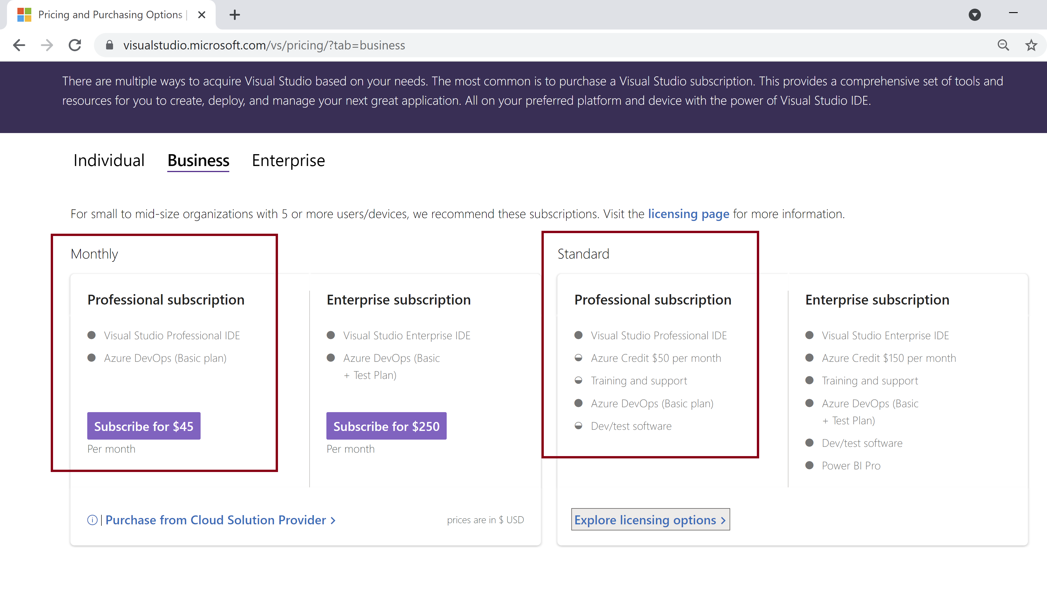
What You Need

Slide 8
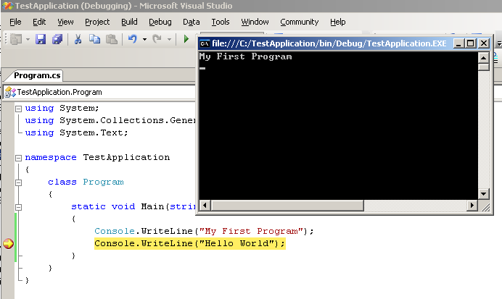
Running and Debugging an Application

Slide 9
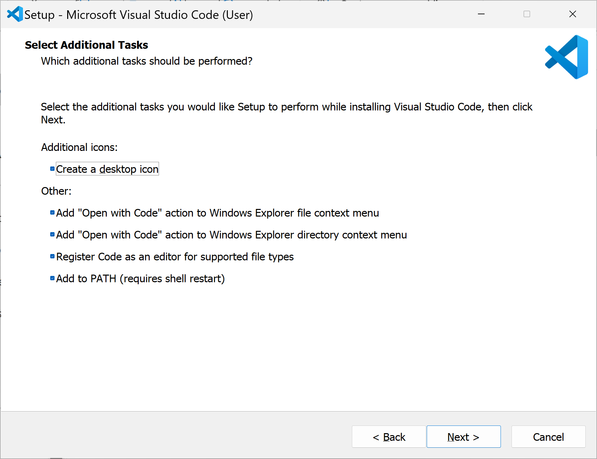
1. Install Visual Studio Code
https://code.visualstudio.com/download

Slide 10
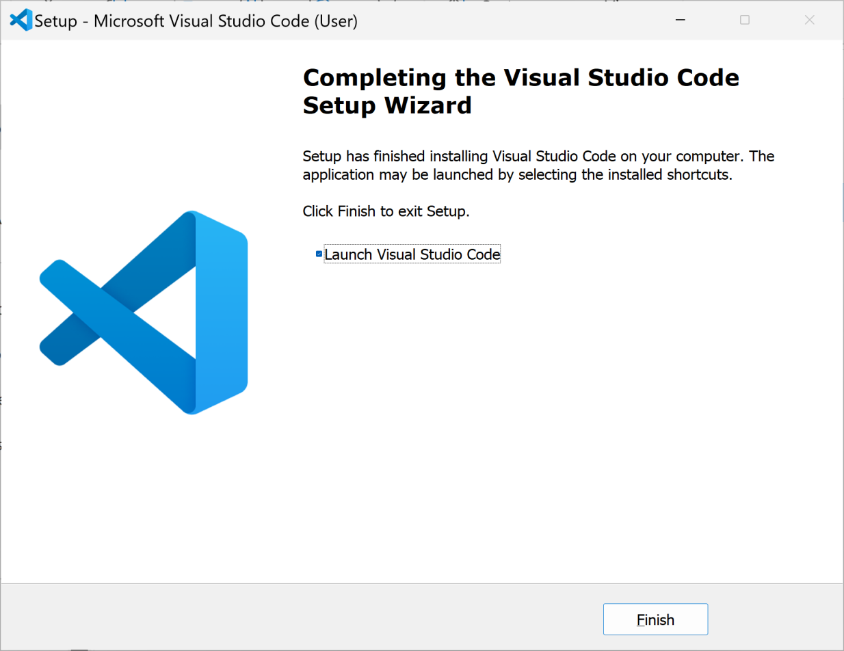
2. Launch Visual Studio Code

Slide 11
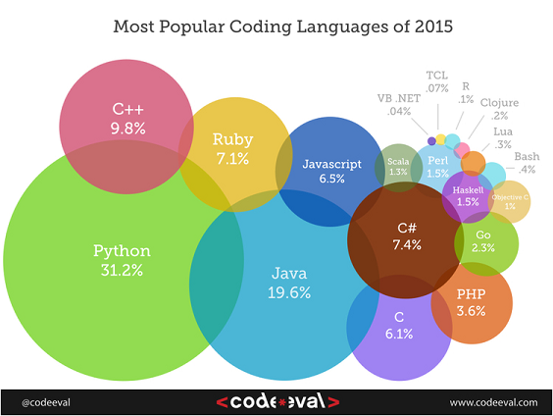
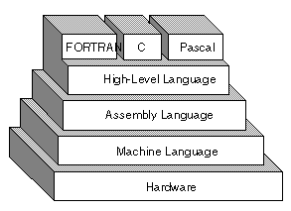
Programming Languages

Slide 12
Why C#?

Slide 13


How To Speak A Language?

Slide 14
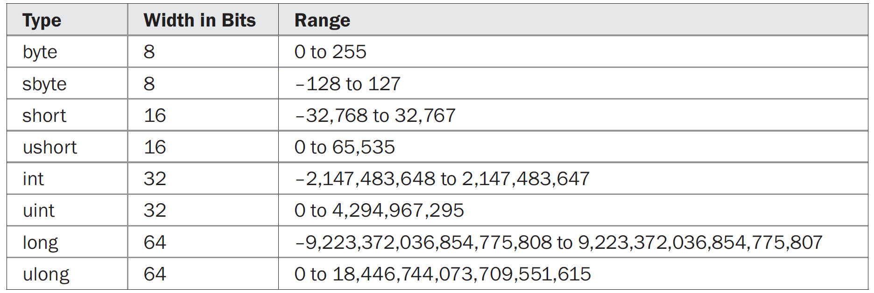


Primitive Types [1, 2]
char code = 'Z';
String name = "Ngo Huy Bien";
A string literal is a set of characters enclosed by double quotes.

Slide 15

How To Speak A Word?

Slide 16
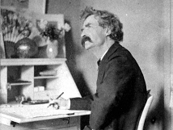
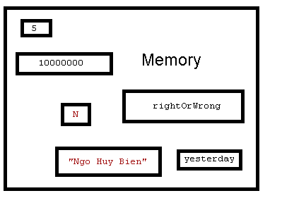
How Does A Computer Remember A Word? [3]
A variable is a memory location where a value is stored.
Before you use a variable in your program, however, you must declare it.
Using the variable, your program can store or read the value stored in memory.

Slide 17
How To Declare Multiple Variables? [1]
Array is a group of elements that are accessed by indexing.
Item 0
Item 1
Item 2
Item 3
Item N-2
Item N - 1
3.2 |  |  | 4.1
 |  | 3.4
 |  |  |  |  | 4.4

Slide 18
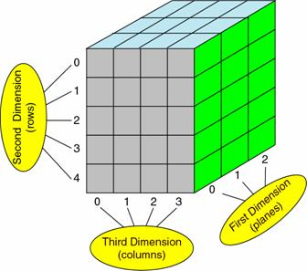
Multidimensional Arrays

Slide 19
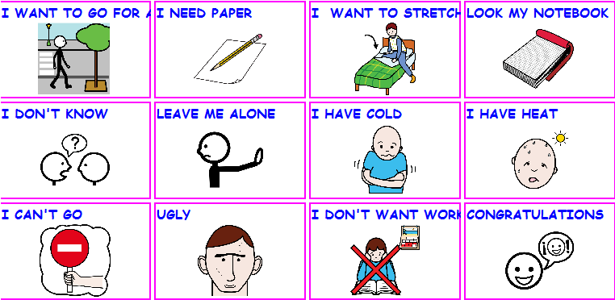
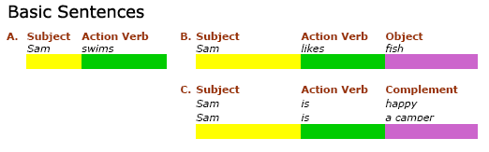
How To Make A Simple Sentence?

Slide 20
Statement, Block Of Code

Slide 21
Arithmetic and Assignment Operators

Slide 22
Conditional And Logical Operators
Conditional operators
a | b | a AND b | a OR b | NOT a
True | True | True | True | False
True | False | False | True | False
False | True | False | True | True
False | False | False | False | True
Logical operators
 | Decimal | Binary
a | 1 | 00000001
b | 3 | 00000011
a AND b | 1 | 00000001
a OR b | 3 | 00000011
a XOR b | 2 | 00000010
If the result of the entire operation can be determined by the first argument, the second argument is not evaluated.
Bitwise operations have to evaluate both sides in order to compute the final value.

Slide 23
Relational, Increment, Decrement, and Shift Operators
Bitwise operators
 | Decimal | Binary
i | 3 | 00000011
i << 1 | 6 | 00000110
i << 2 | 12 | 00001100
i >> 1 | 1 | 00000001
i >> 3 | 0 | 00000000

Slide 24
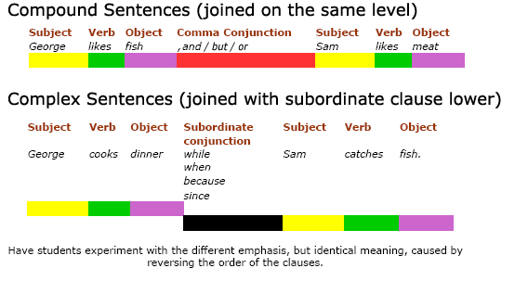
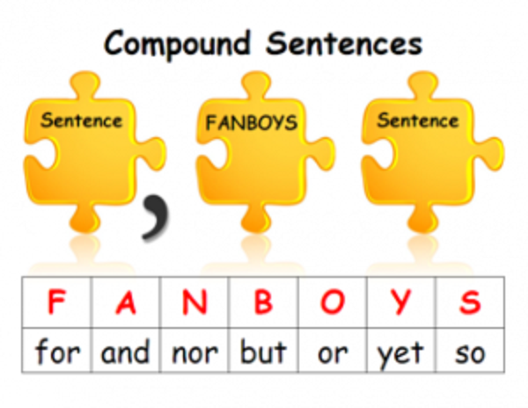
How To Make A Complex Sentence?

Slide 25
Selection Statements
if (Boolean-expression)
statement1
[else statement2]
switch (expression)
case constant-expression:
statement
jump-statement
case constant-expression:
statement
jump-statement
[default]

Slide 26
Iteration Statements (for)
for (initialization; Boolean-expression; step)
embedded-statement

Slide 27
Iteration Statements (while)
while (Boolean-expression)
embedded-statement

Slide 28
Iteration Statements (do… while)
do
embedded-statement
while (Boolean-expression)

Slide 29
foreach Iteration
foreach (type in expression)
embedded-statement
Ngo
Huy
Bien
student

Slide 30
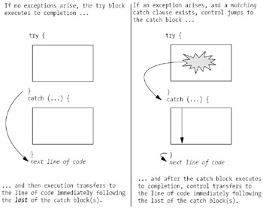
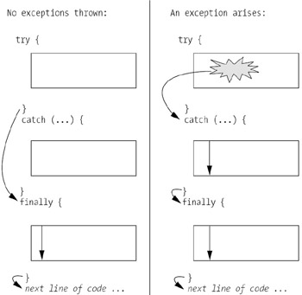
try/catch/finally

Slide 31
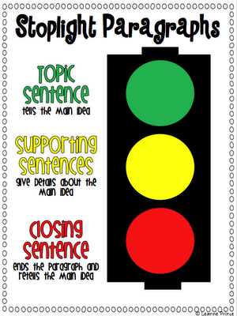
How To Make A Paragraph

Slide 32
Function/Method [3]
Methods are blocks of code that can be called and executed from other code.
Name
Statement1, statement2, statement3,…
Inputs (parameters)
Outputs
(return values)

Slide 33
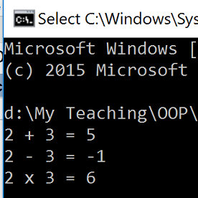
Multiple Outputs

Slide 34
Exercise

Slide 35
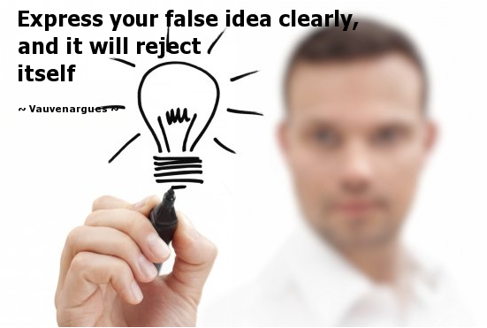

How to Express Your Ideas

Slide 36

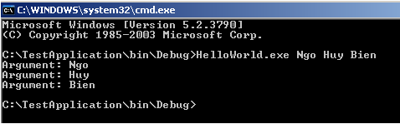
Main Method
Application’s entry point.
Application’s exit point.

Slide 37

Thank You & See You Again

